Slide 2




Fashion & Co.
Home
Product
About Us
Contact
FASHION
Page |
01

Slide 3
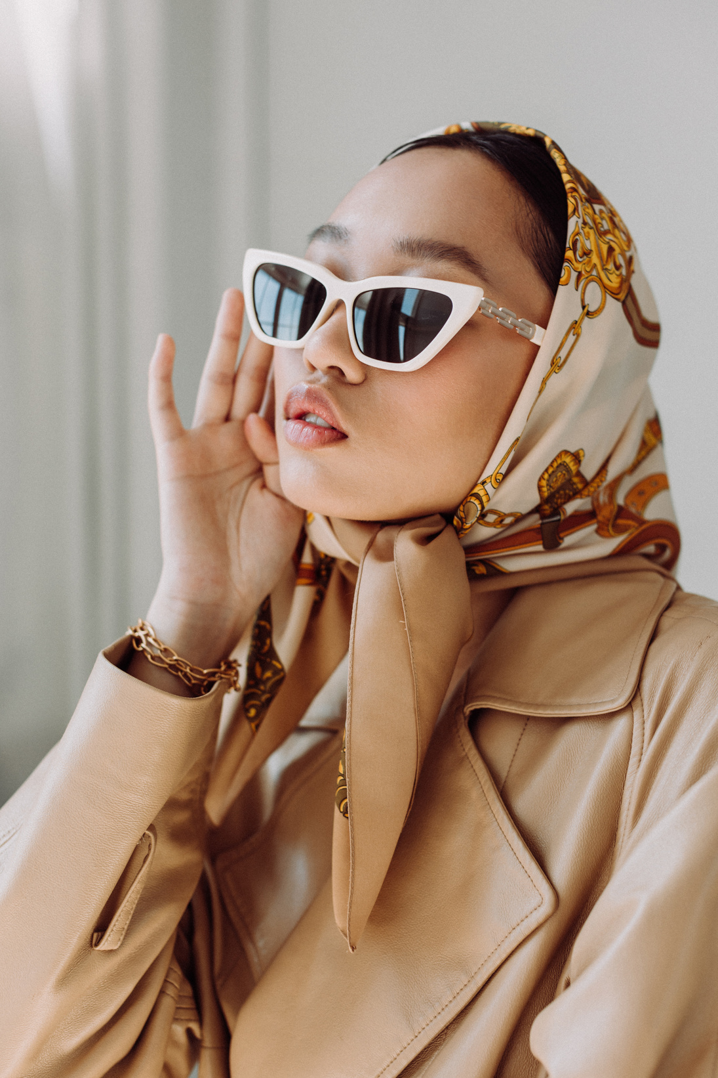
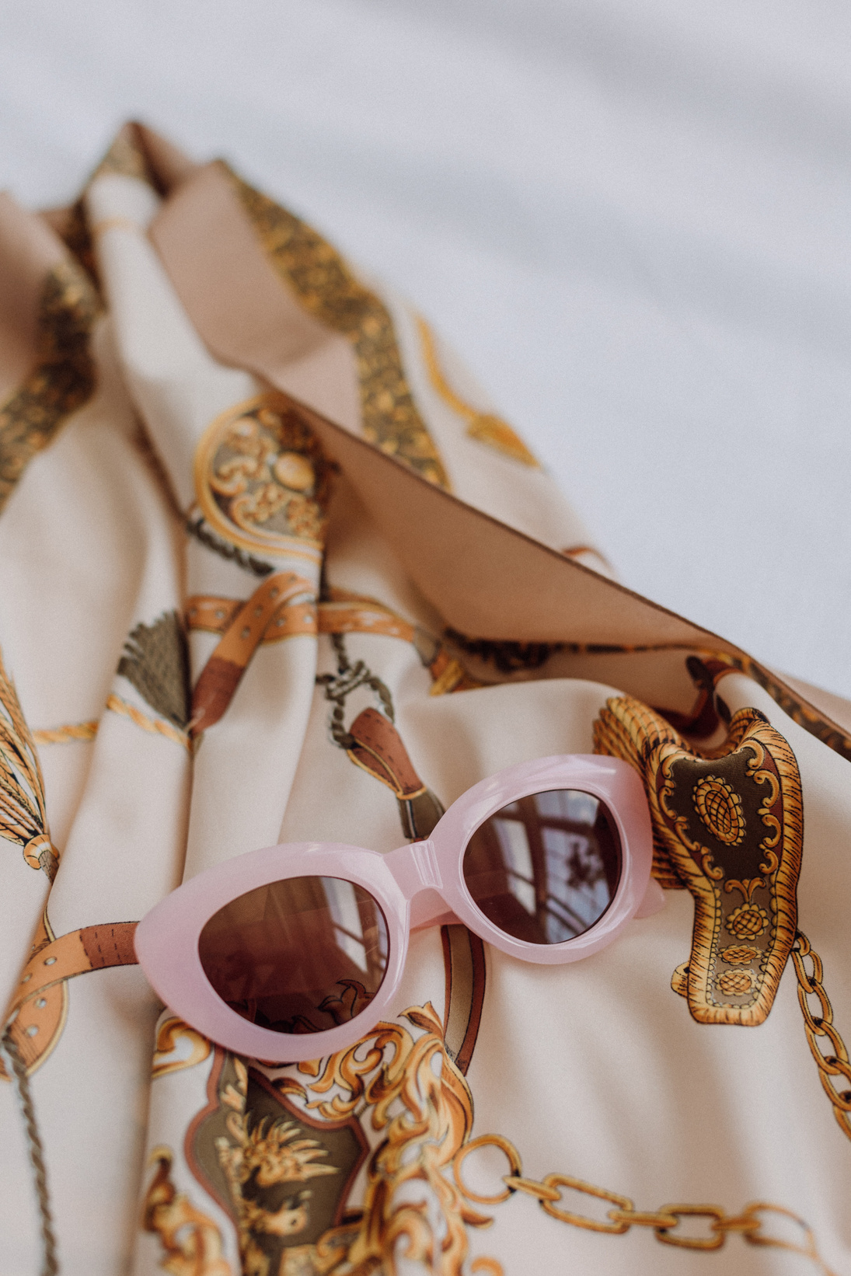
Fashion & Co.
Home
Product
About Us
Contact
INTRODUCTION
Welcome to STYLESTOCKS
Tagline: "Making fashion accessible with cutting-edge AI solutions."
What is STYLESTOCKS?
A revolutionary fashion platform designed to bring stylish and affordable clothing to everyone.
Powered by AI technology, we simplify the shopping experience by:
Suggesting personalized outfits.
Offering trend updates based on your preferences.
Helping you discover clothing that fits your style, effortlessly.
Our Mission
To bridge the gap between high fashion and accessibility.
To empower users with AI-driven tools for smarter and faster fashion decisions.
To create a seamless shopping experience that inspires confidence and style.
Page |
02

Slide 4
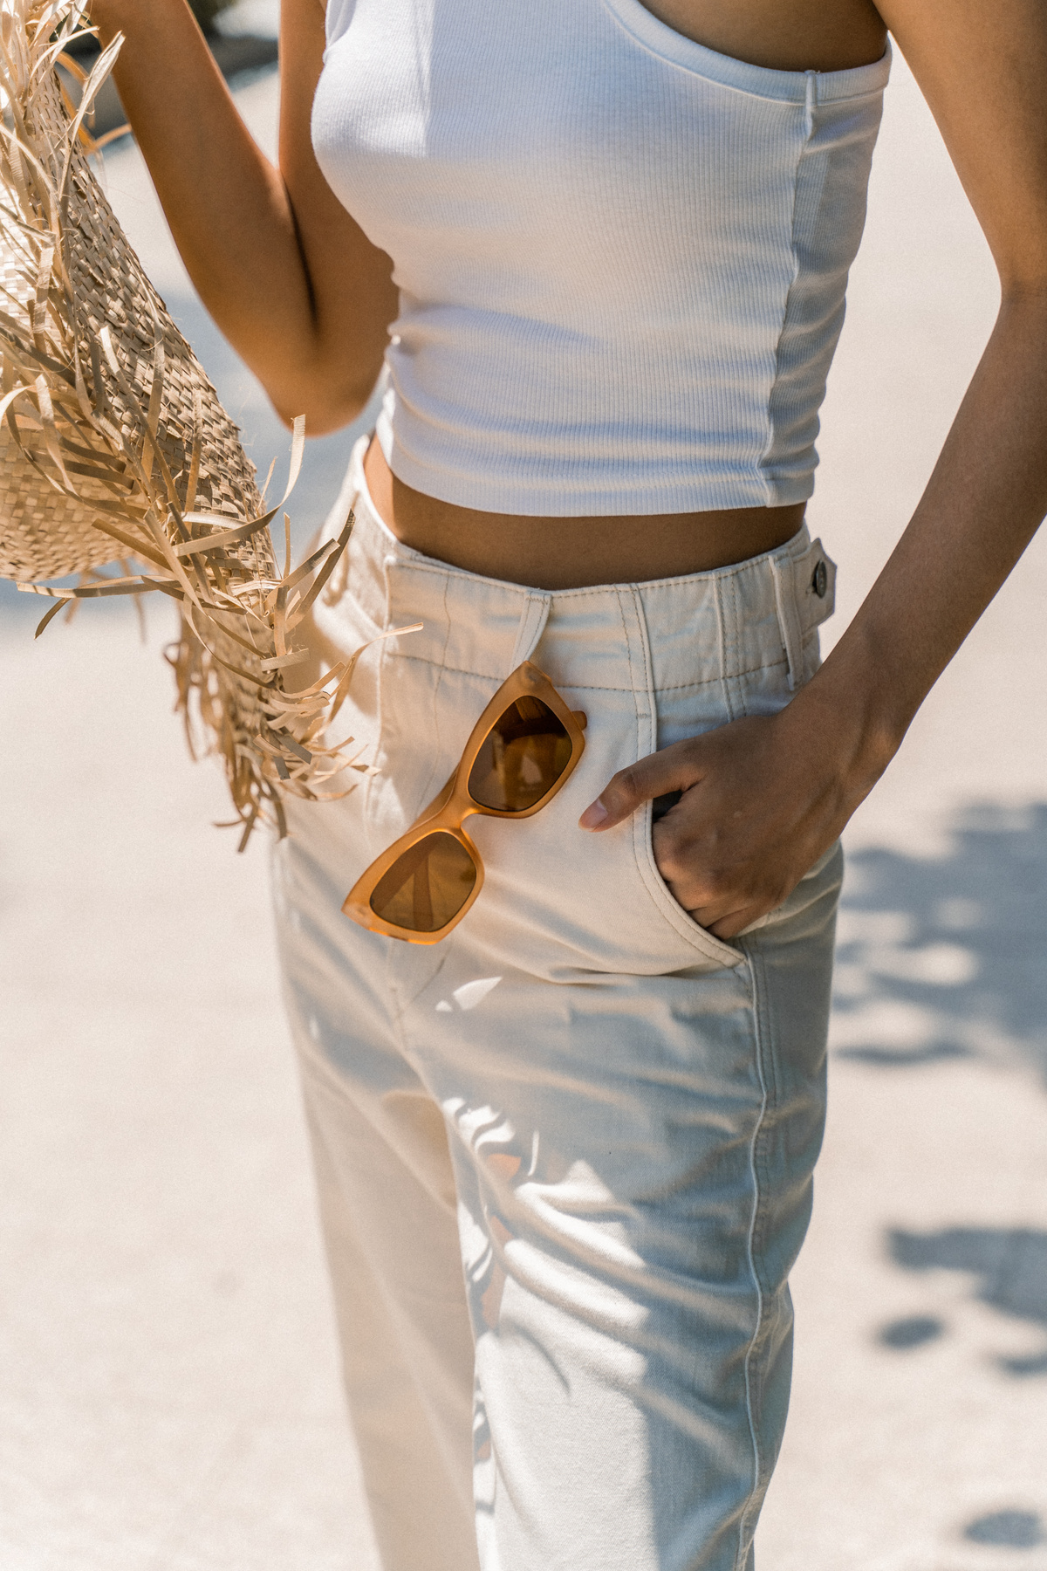
Fashion & Co.
Home
Product
About Us
Contact
OUR PRODUCT
Target Audience
Age Group: 18+ (young adults).
Demographics: Tech-savvy men and women, students, and professionals.
Preferences: Trendy, affordable clothing with a seamless shopping experience.
Current Trends & Gaps
No Personalization: Lack of tailored recommendations.
Style Guidance: Minimal help in outfit pairing.
Trend Updates: Limited insights into current fashion.
Sustainability: Growing demand unmet by competitors.
Clunky UX: Poor interfaces and mobile optimization.
Competitor Analysis
Competitors: Myntra, ASOS, Shein, etc.
How STYLESTOCKS Stands Out:
AI-driven personalization and trend detection.
Easy navigation and inclusive collections.
Style tips and outfit pairing suggestions.
Page |
03

Slide 5
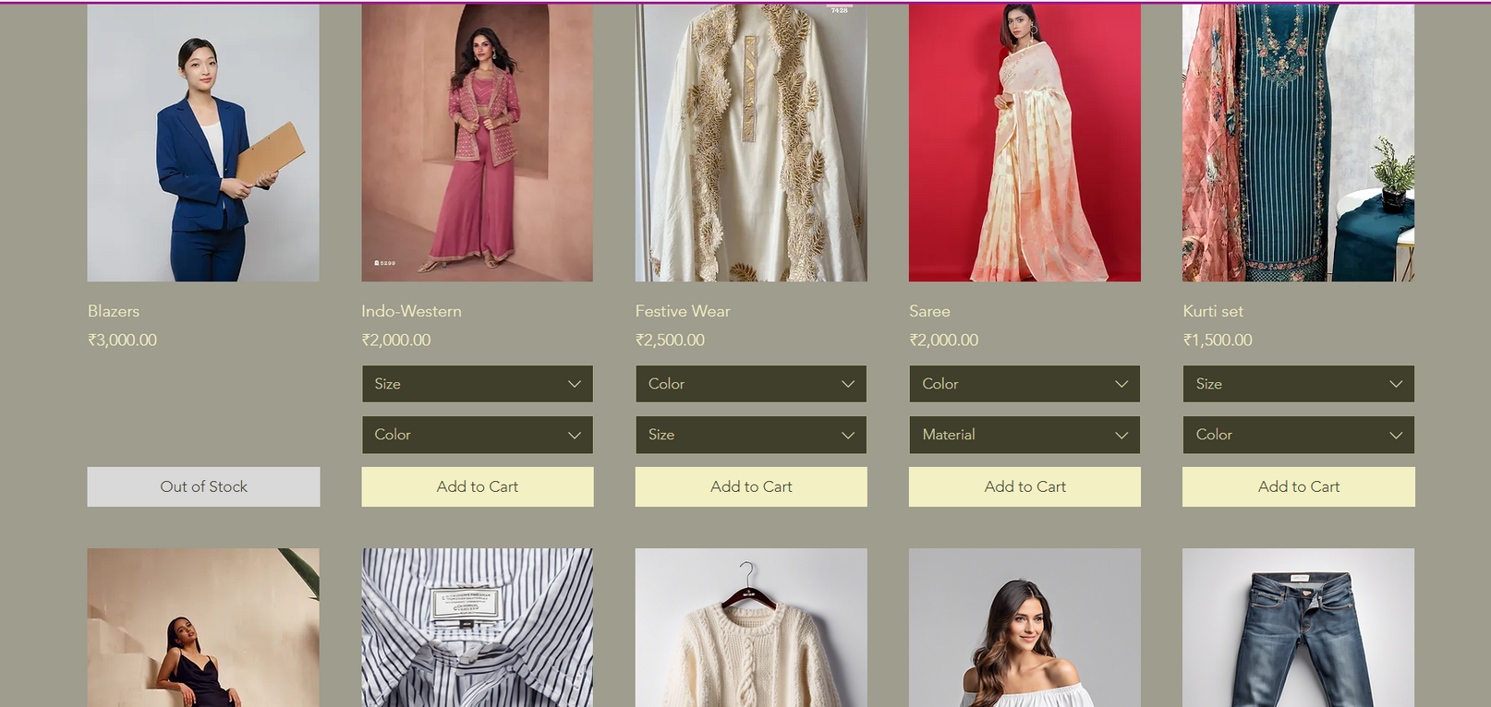
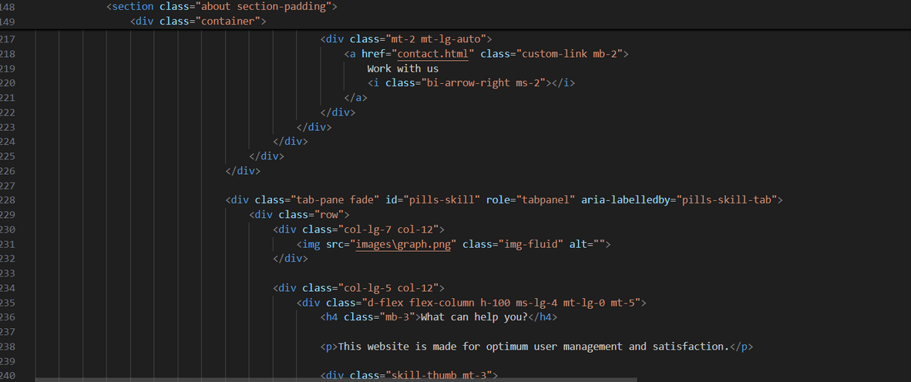
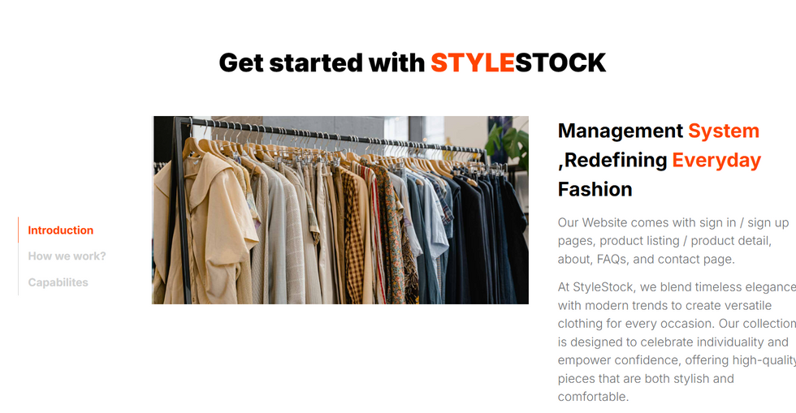
Fashion & Co.
Home
Product
About Us
Contact
NEW FASHION
Screenshots of the Final Website
Page |
04

Slide 6
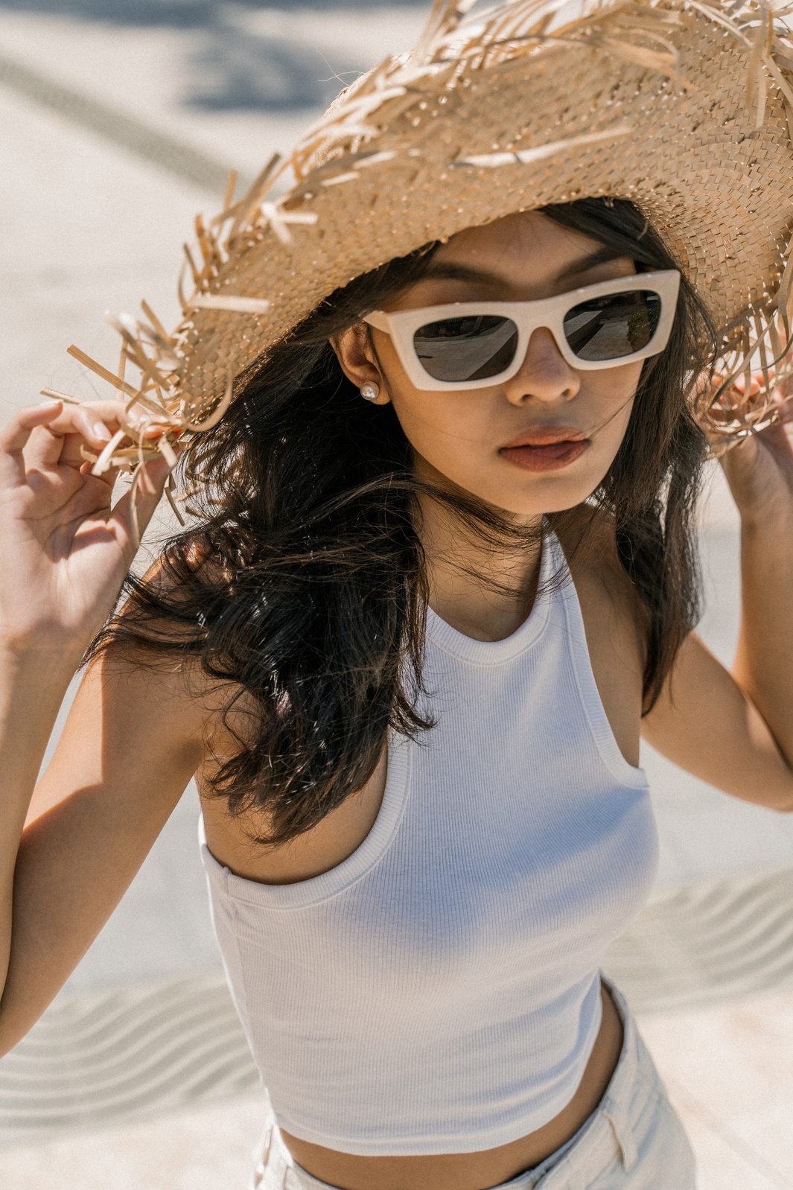
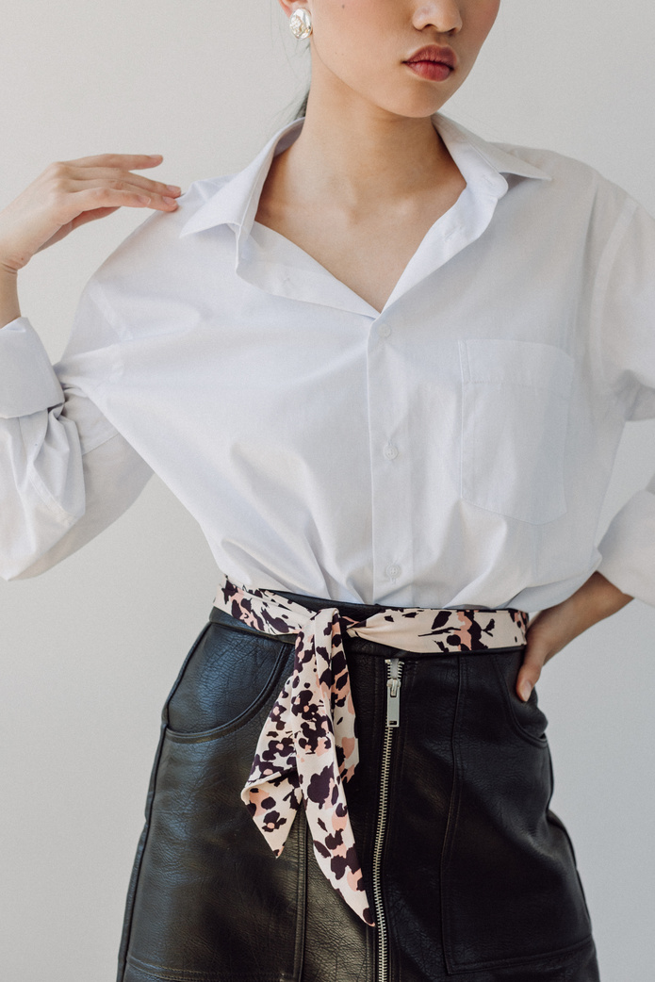
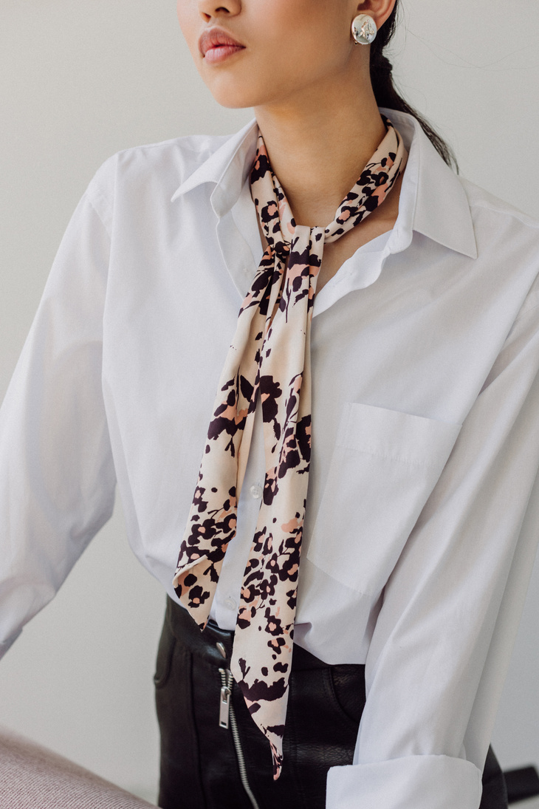
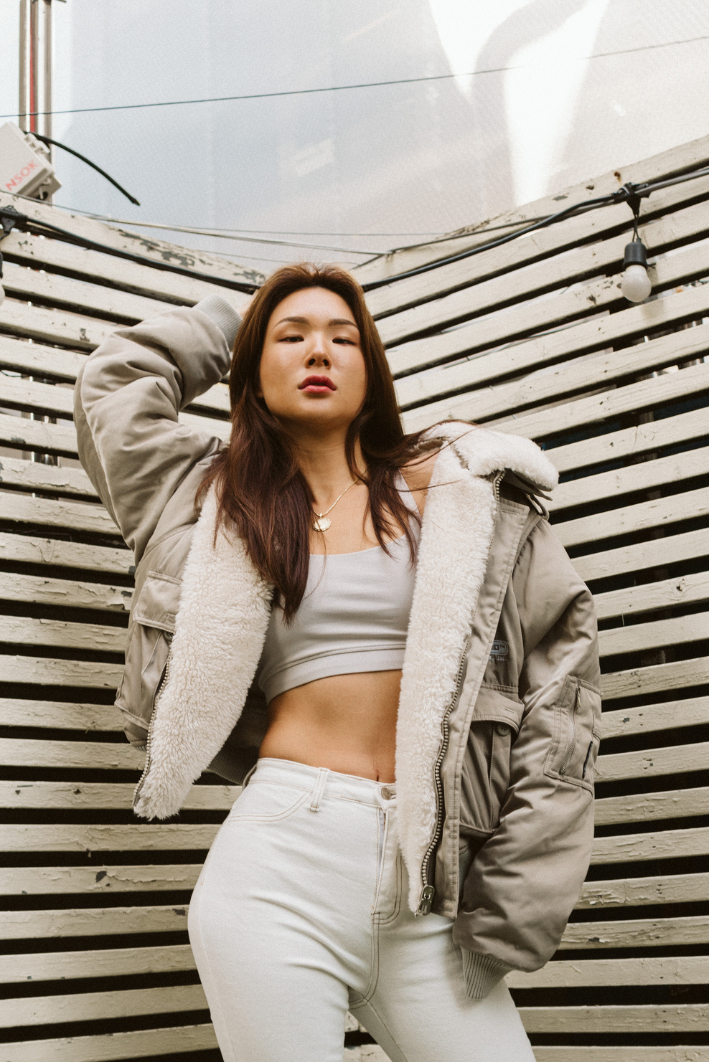
Fashion & Co.
Home
Product
About Us
Contact
OUR VISION
01
Empowering Personal Style
We aim to help individuals express their unique fashion sense with AI-driven recommendations and styling tools.
02
Simplifying the Shopping Experience
By merging technology with fashion, we make finding the perfect outfit effortless and enjoyable.
03
Championing Inclusivity
Our platform celebrates diversity, offering styles that cater to all genders, sizes, and preferences.
04
Making Fashion Accessible Globally
We bring trendy, affordable clothing to every corner of the world, bridging gaps in the fashion market.
Page |
05

Slide 7
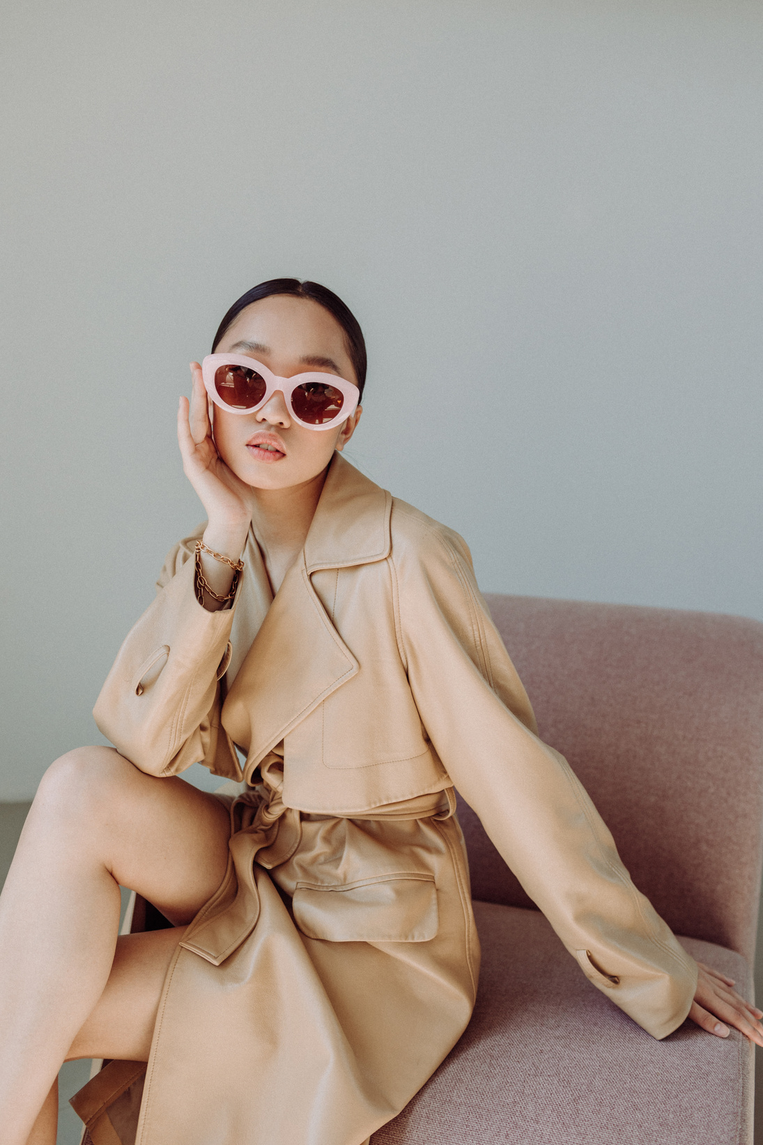
Fashion & Co.
Home
Product
About Us
Contact
OUR MISSION
01
02
Transform Fashion Shopping
To revolutionize online shopping with personalized, AI-driven experiences that make fashion easier and more fun for everyone.
Deliver Affordable Style
To offer a wide range of trendy, high-quality clothing at accessible prices, making style achievable for all.
03
04
Stay Ahead of Trends
To keep our users at the forefront of fashion by constantly updating with the latest styles and trends tailored to their preferences.
Create a Seamless Shopping Journey
To provide a smooth, user-friendly platform that simplifies the process of discovering, choosing, and purchasing clothing.
Page |
06

Slide 8
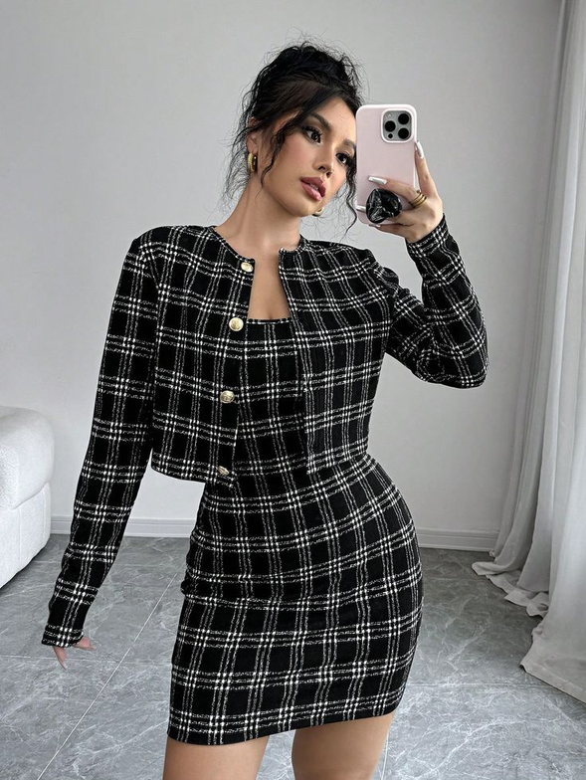
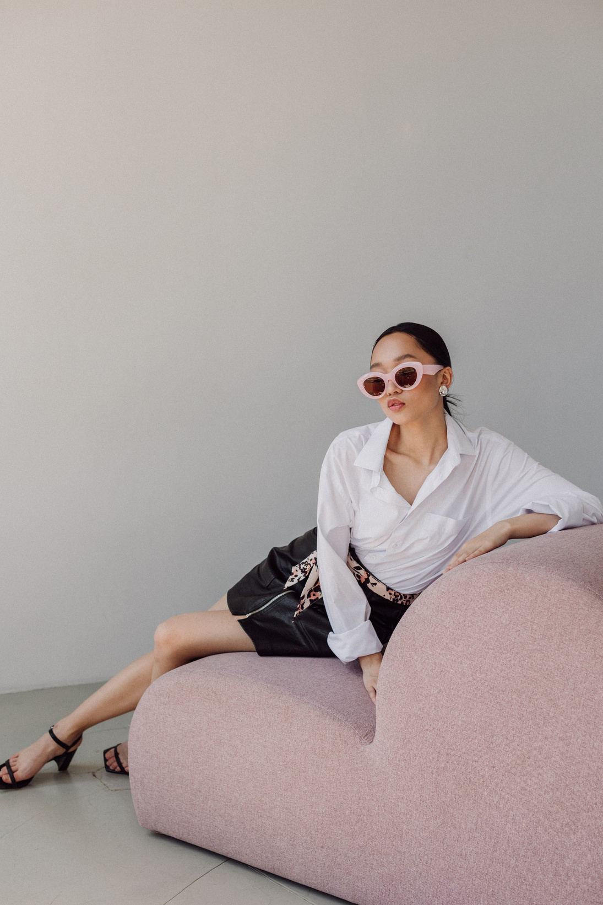
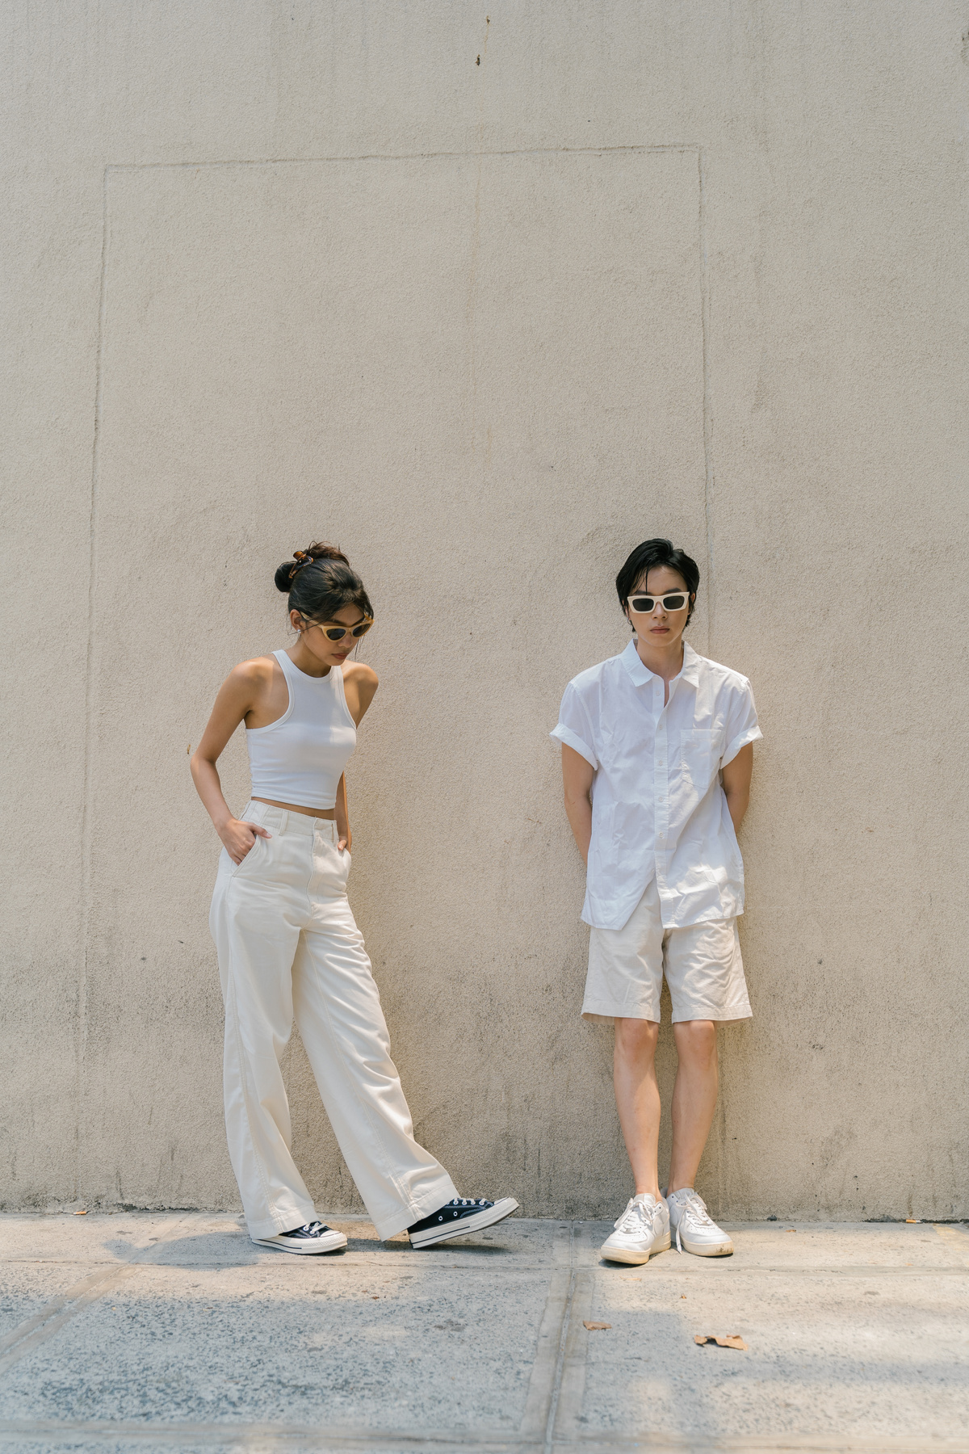
Fashion & Co.
Home
Product
About Us
Contact
OUR PORTFOLIO
Our Portfolio features a diverse collection of trendy, affordable, and high-quality fashion for both men and women, including clothing, accessories, and seasonal collections. We prioritize providing a seamless shopping experience with an intuitive interface and easy navigation. Our platform offers a variety of styles to cater to different preferences, ensuring something for everyone. Additionally, we focus on sustainability by offering eco-friendly fashion options and collaborating with ethical brands, making fashion accessible and responsible for customers worldwide.
Page |
07

Slide 9

Fashion & Co.
Home
Product
About Us
Contact
CHALLENGES FACED
Maintaining Accurate Inventory
Keeping up with demand and ensuring that the website always reflects real-time stock levels can be challenging, especially with popular items selling out quickly.
01
User Experience Consistency
Delivering a seamless, intuitive experience across all devices (desktop, tablet, mobile) while maintaining speed and functionality requires continuous updates and optimization.
02
Sustainability vs. Affordability
Striking a balance between offering sustainable, eco-friendly fashion and keeping prices affordable for a wide audience is an ongoing challenge.
03
Competition
With many established players in the fashion market, differentiating the brand and attracting customers can be tough, requiring constant innovation and a unique value proposition.
04
Page |
08

Slide 10
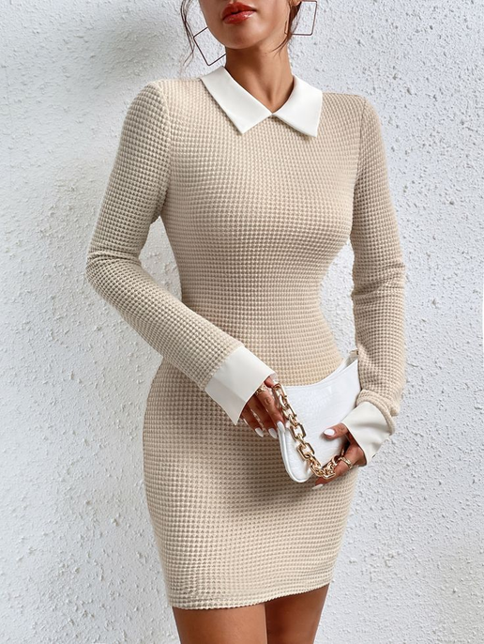
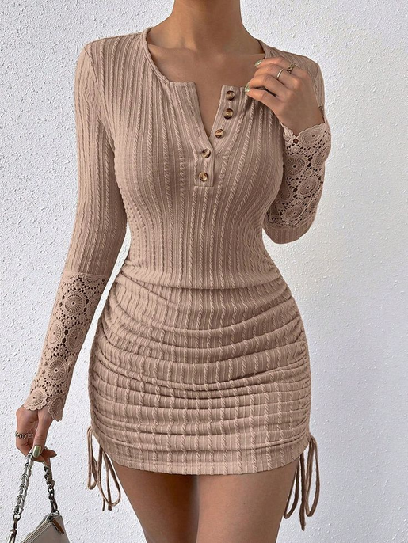
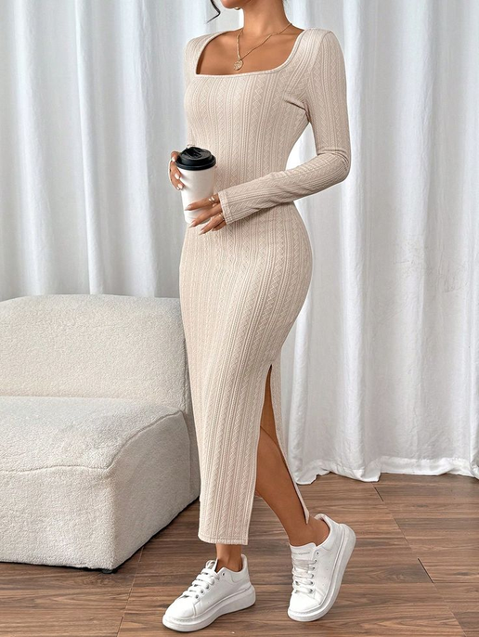
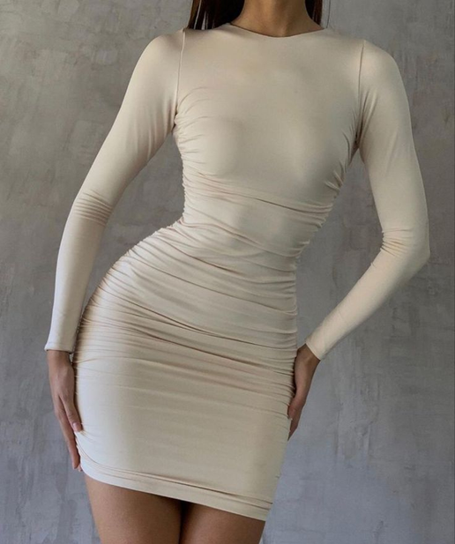
Fashion & Co.
Home
Product
About Us
Contact
FUTURE PLANS
Expansion Ideas
We plan to introduce a virtual try-on feature or AR integration, allowing users to visualize how clothing fits and looks in real-time, enhancing their shopping experience.
01
Global Reach
Expanding our delivery services worldwide to ensure our fashion collections are accessible to customers around the globe, with reliable and fast shipping options.
02
Community Building
We aim to create a community-driven platform, including forums and style-sharing features, where users can connect, share their looks, and inspire each other.
03
AI Integration
A key part of our future growth involves adding AI-driven tools to further personalize the shopping experience, with features like smart styling advice, trend forecasting, and enhanced product recommendations based on individual preferences.
04
Page |
09

Slide 11
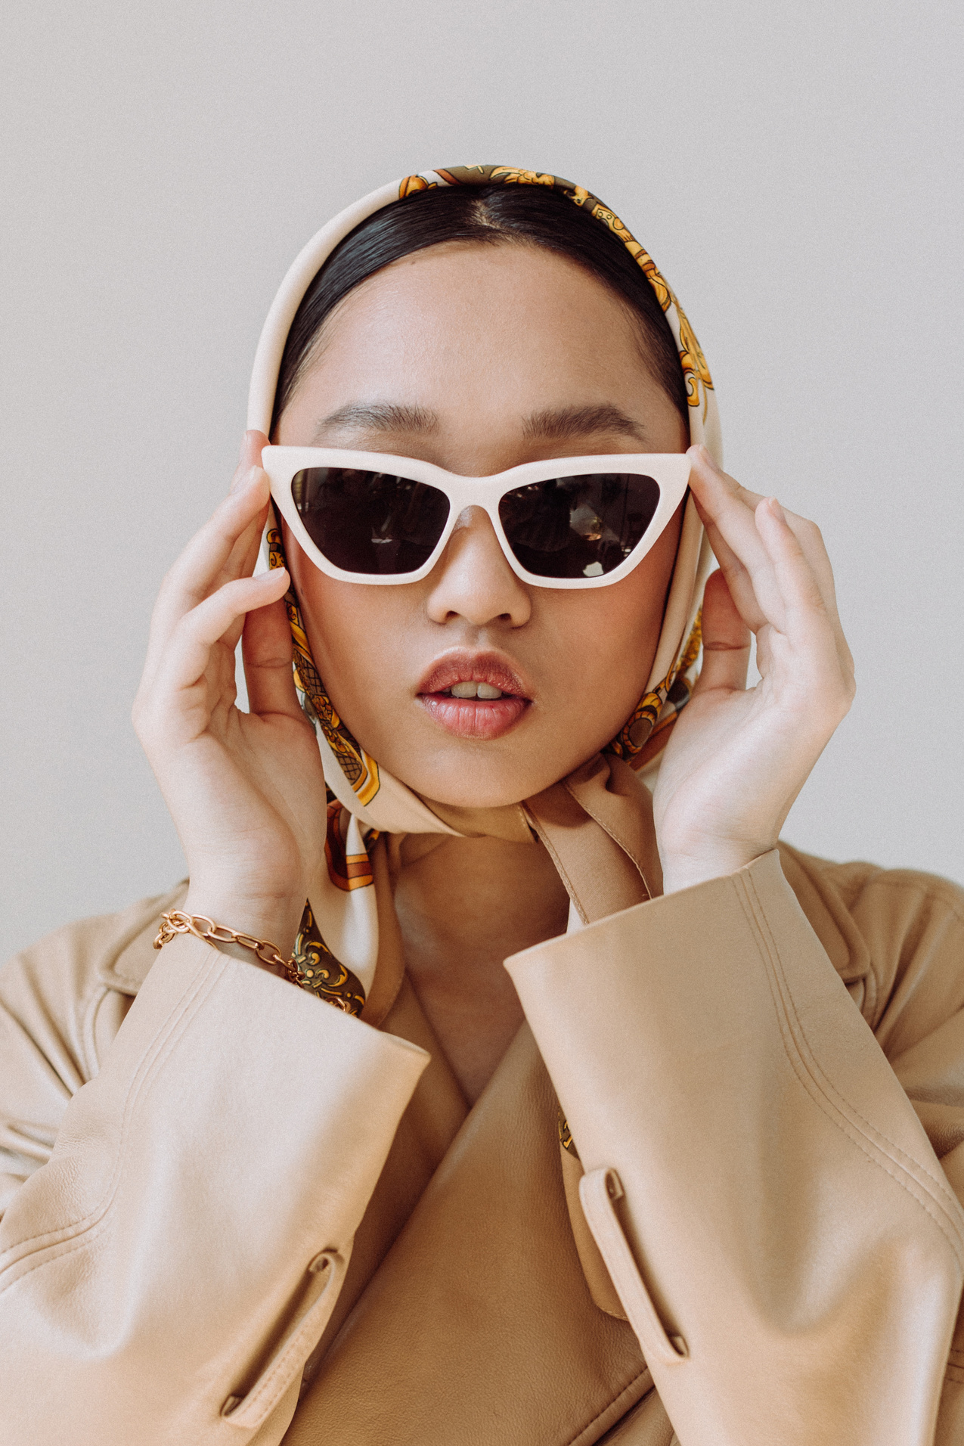
Fashion & Co.
Home
Product
About Us
Contact
THANK YOU
Page |
10

